Slide 1
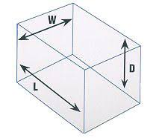

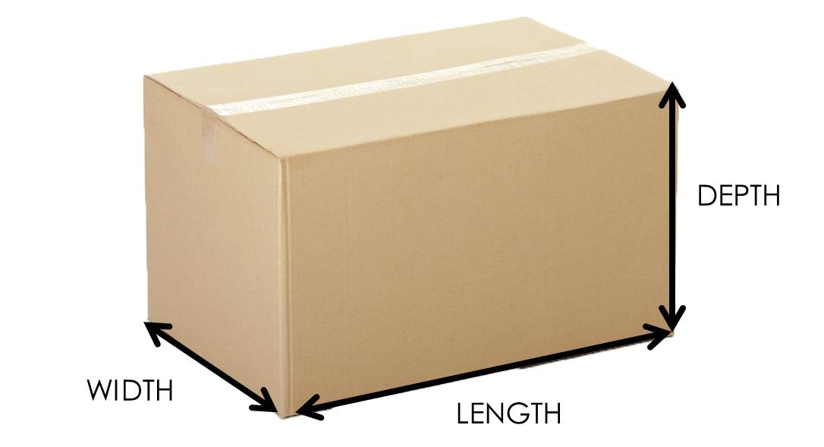

Box Volume Measurement System
Savitribai Phule Pune University Faculty of Information Technology
Department of Information Technology
Ishwar Gujjarwar
Adnan Tamboli
Amir Khan
Aditya Khaparde

Slide 2
Savitribai Phule Pune University Faculty of Information Technology
Department of Information Technology
Group Id: |  |  |  | 15 | (Academic Year :2022-23) |  |  | Date: 08/09/2022
Project Title: Box Volume measurement System
Sr. No. |  |  | Roll No. |  | Student Name | Contact Details |  | Internal / External Guide Details (Name, Email Id & Mobile No)
1 |  |  |  |  |  |  |  | Mrs. Meenakshi Thalor
 |  |  | 30 |  | Ishwar Gujjarwar | 9130832881
2
 |  |  | 78 |  | Adnan Tamboli | 9822399437
3 |  |  | 43 |  | Amir Khan | 7506657032
3 |  |  | 53 |  | Tejas Maramwar
4 |  |  | 45 |  | Aditya Khaparde | 7499304113
4 |  |  | 61 |  | Chirag Naikwadi

Slide 3
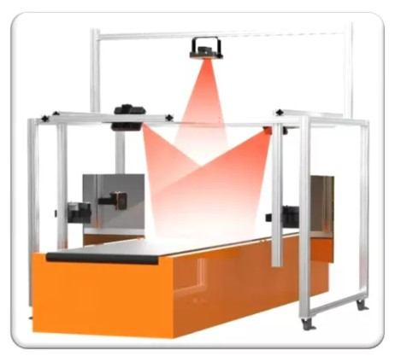
Contents
INTRODUCTION
PROBLEM STATEMENT
MOTIVATION
PROJECT SCOPE
OBJECTIVES
REQUIREMENTS
LITERATURE SURVEY

Slide 4


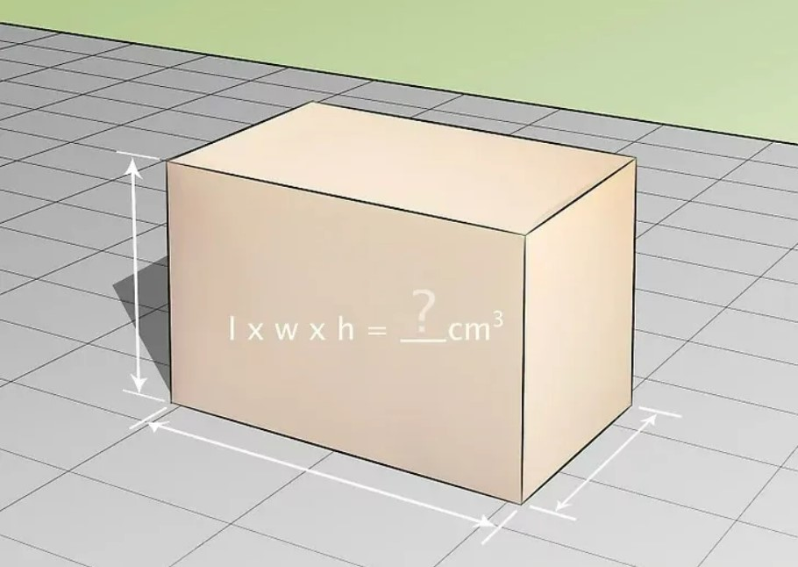
Introduction
Box Volume measurement using Mobile camera and Aruco Marker.
Implementing Computer Vision in Python.
A System that can help detect dimensions and volume of a box with High accuracy and extremly low cost.

Slide 5

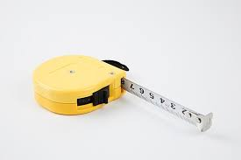

Problem statement
Warehouse companies need robust system for volume measurement.
Spending high time and cost on measurements.
Developing a cost effective and mobile system for measurement.

Slide 6
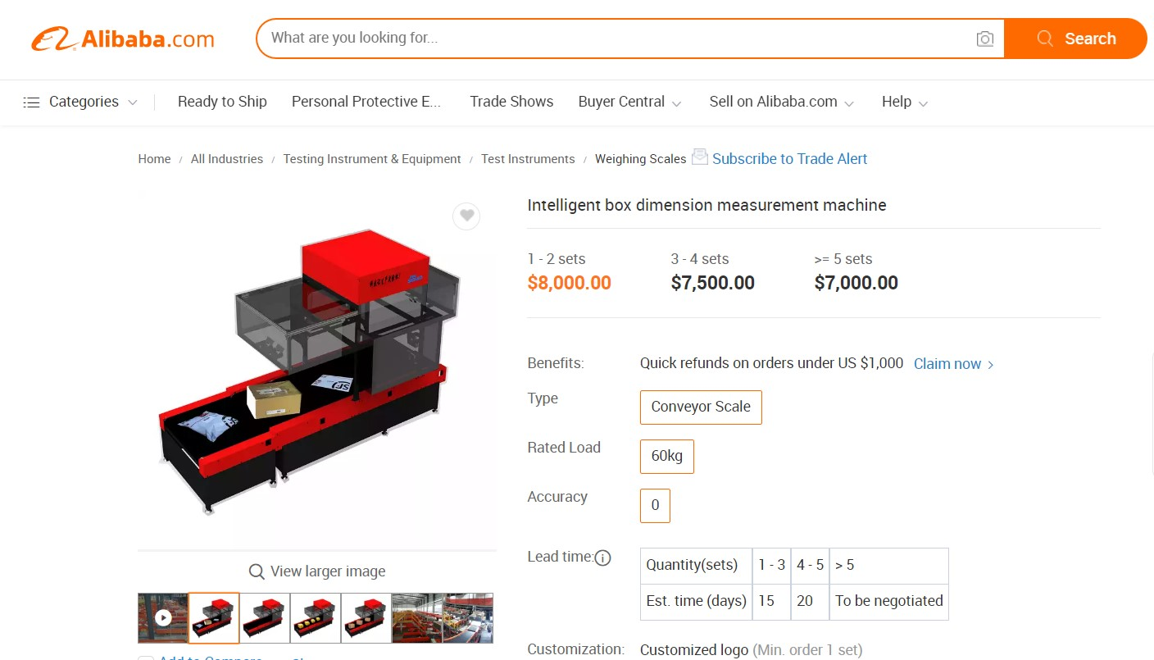
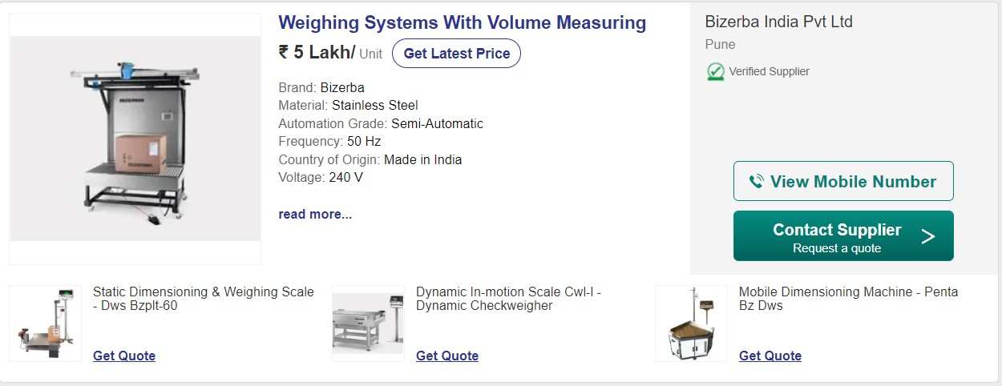
Motivation
Existing Systems
Very High Cost
Hard to Install and calibrate
Space consumption
Many points of failure
Hard to learn and use

Slide 7
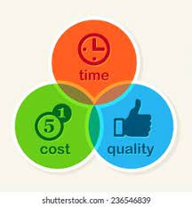
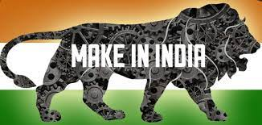

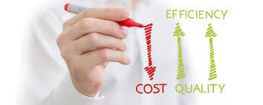
Motivation
Automated System
Time Efficient
OUR SYSTEM
Mobile (easy to move)
Low Cost
Less Real Eastate

Slide 8

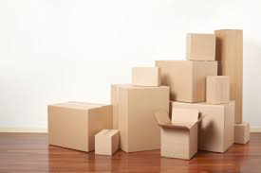

Scope
This system will be highly accurate for square, rectangular.
System not yet efficient for other polygonal shaped objects.
Threshold for height and width for an object to be measured.
Currently does not support or weigh the weight of object.
Available for android OS and Windows OS.

Slide 9
Flow Application (High Level)
START
Image Input
Image Preprocessing
Object Detection
(Detect Edges)
ArUco Marker Detection
Calculate Volume & Display the Volume
Forward the dimensions for Volume calculation
Detecting approx. dimensions of the box
Unit Conversion
(Pixels to cm)
END

Slide 10
Literature Survey
Sr. No. | Title of Paper | Description | Conclusion
1 | A Practical Framework for the Development of Augmented Reality Applications by using ArUco Markers | Usually, an ArUco marker is represented by a matrix of 7 × 7 items, where each black border has a thickness of 1 item and the internal pattern is a sub-matrix of 5×5 items. This means that the internal pattern is composed of 5 rows each of which with a length of 5 binary items (i.e., black or white). The designers have employed a slight modification of the Hamming Code for the codification of each marker, where 2 bits are used for the information and 3 bits are used for the error detection. As a consequence, it is possible to generate up to 1024 different markers. | Moreover, their recognition is very fast with a low level of ambiguity in indoor environments. As for the previous libraries, the recognition of the ArUco markers in outdoor environments is a hard task. This last aspect is crucial for this kind of systems. Finally, the ArUco library is free for research purposes and it has been recently included within the last stable version of OpenCV 3.0

Slide 11
Literature Survey
Sr. No. | Title of Paper | Description | Conclusion
2 | OBJECT DETECTION AND DIMENSIONING USING OPENCV | In these days of the 4th industrial revolution, real-time object detection and dimensioning is an important aspect from an industrial point of view. These are requisite topics of computer vision problems. This study presents an augmented technique for detecting objects and computing their real-time measurements from an IoT video device such as a webcam. We have suggested an object measurement technique in real-time using AI and IoT technologies like OpenCV libraries and webcam respectively. OpenCV includes many libraries and algorithms that are used. And we are using Algorithms like canny edge detection algorithm[2] and mobile/ web camera capture video in this paper. | Because of this framework, numerous enhancements can be made to the modern area[8]. The task effectively gauges the elements of the article progressively. Consequently the PC vision (webcam gadget and code) is utilized to gauge the aspects progressively. It catches the picture from the real-time video casing and afterward shows its aspects. A Canny edge locator is effectively used to identify the aspects[2]. This procedure works quick and enjoys many benefits and remarkable highlights that can be carried out in reality.

